Slide 1
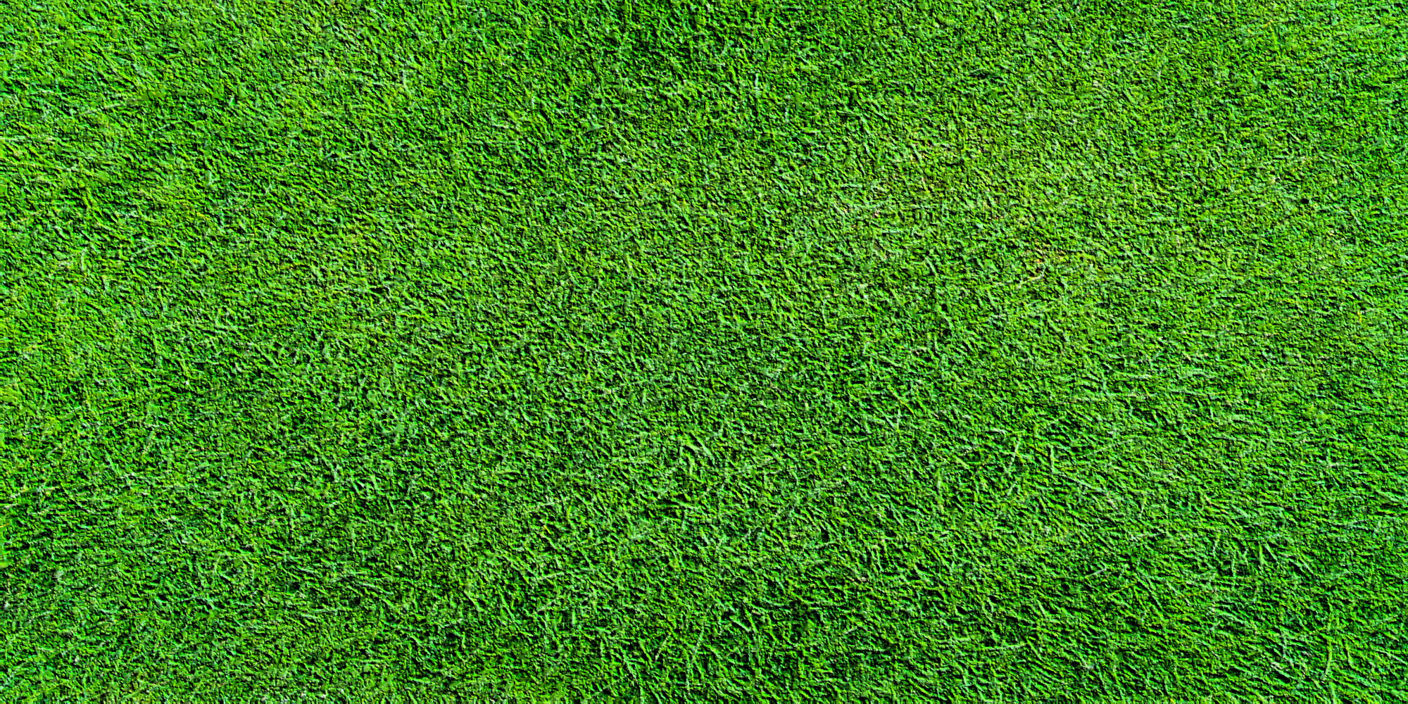
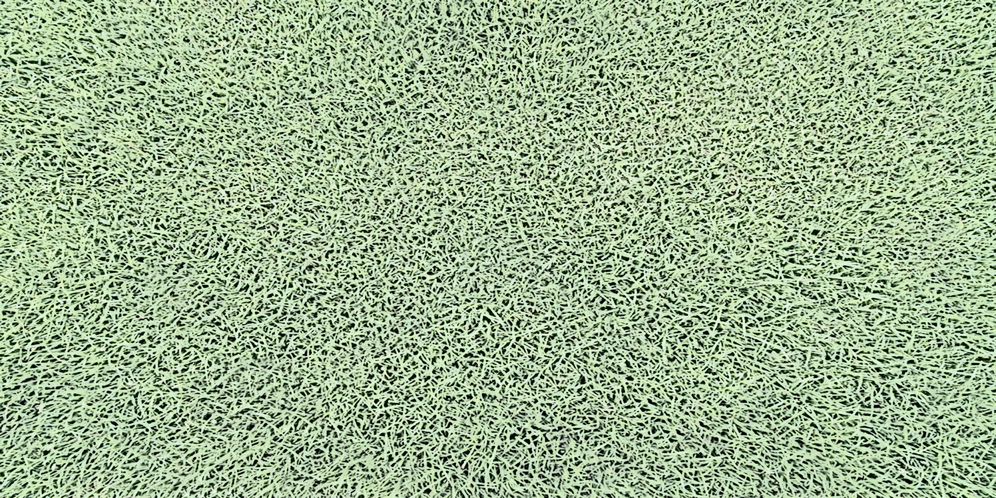







Dead hedge
Wildlife area 1
Upper Back Track / parking
Lower Back Track / parking
Larry’s bridge
51
83
Woodchips
Orchard
Parking / turning
T10
T8
Chesil Beach
T4
Second avenue
T6
Upper field
Track 2
Track 1
Raised beds x 5
T2
Middle hedge
Bottom hedge
Hedge path
29
Gate 1
Bottom track – closed to traffic
66
Lower field
T3
T1
Raised beds x 7
Main avenue
One way
Public footpath
One way
T9
T7
Gate 4
T5
The Shed
The Shop
Manure pen
91
71
Car park
131
61
Gate 5
6
1
Gate 8
Gate 7
Gate 6
Gate 3
Gate 2
Albany Road
To Cricket Club
See over for map key and Shop details
Notes:
Version 1 25-07-02

Slide 2










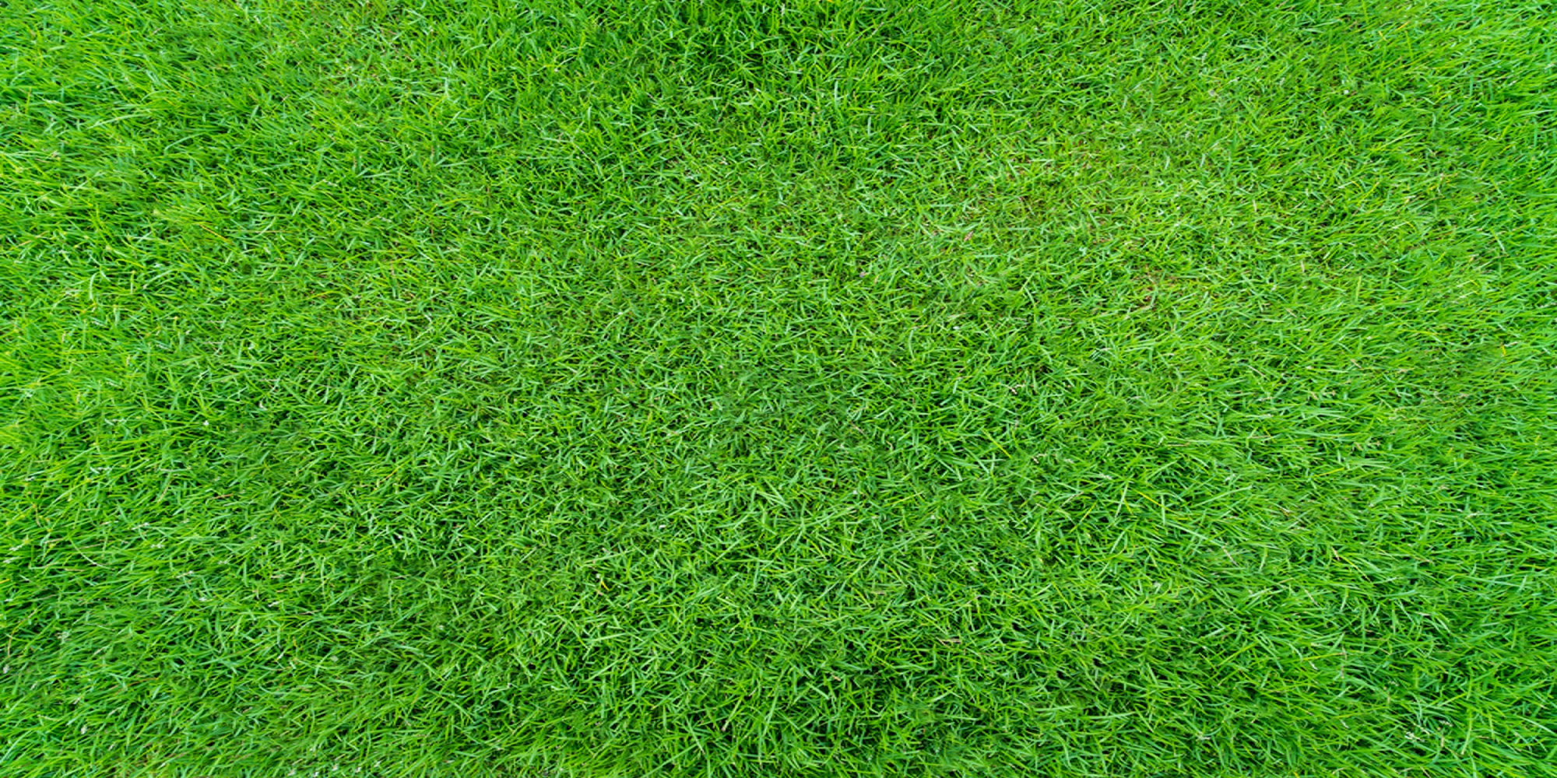
Shed area details
Key
 | Hedge
 | Track – cars allowed
 | Path – foot traffic only
 | Shingle path – foot traffic only
 | Path – foot traffic, wheelchairs and mobility scooters only
 | Ditch
 | Plots, small paths
 | Wildlife area
 | Plot number
 | Tap number
Rainwater butts
Manure pen
Storage compound
Storage
Toilet
Kitchen area
First aid kit
Members’ lounge
Car park
Strimmers
29
The Shop
Tx
Albany Road

